Slide 1
Introduction to Law of Torts
At
Rajkot
December 1, 2019
By
Dr. Kalpeshkumar L Gupta
Associate Professor of Law
Parul Institute of Law, Faculty of Law
Parul University, Vadodara
www.klgupta.in

Slide 2
What do you mean by Law?
klgupta.in

Slide 3
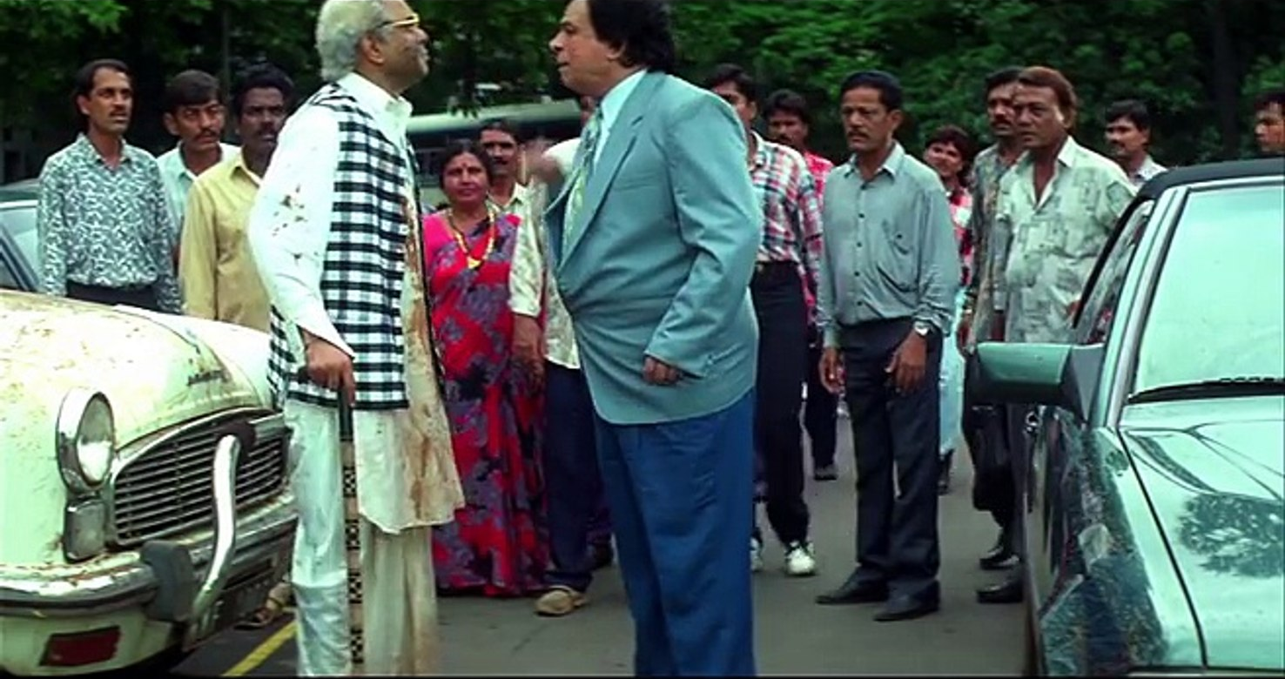
klgupta.in

Slide 4
Ubi jus ibi remedium
where there is a right, there is a remedy
klgupta.in

Slide 5
What is Tort
Tort is
a wrong
Independent of contract
Giving rise to civil remedy
For which compensation is recoverable
Tort is a civil wrong for which you get unliquidated damages.
klgupta.in

Slide 6
What is Tort
According to Salmond
A tort is a civil wrong for which the remedy is a common law action for unliquidated damages, and which is not exclusively the breach of a contract or the breach of trust or other merely equitable obligation.
According to Winfield
Tortious liability arises from the breach of duty primarily fixed by law, this duty is towards persons generally and its breach is redressable by an action for unliquidated damages.
klgupta.in

Slide 7
Origin of Word Tort
Tort
source
Tortum
means
Twist
klgupta.in

Slide 8
Tort & Crime
TORT | CRIME
1. Civil Suit | 1. Criminal Prosecution
2. Pvt. Wrong | 2. Public Wrong
3. Compensation | 3. Punishment
4. Plaintiff | 4. Prosecution
klgupta.in

Slide 9
Tort & Contract
TORT | CRIME
1. Duty imposed by law | 1. Duty imposed by parties
2. No needed | 2. Privity of Contract
3. Unliquidated damage | 3. Liquidated Damage
klgupta.in

Slide 10
Elements of Tort
Every wrongful act is not a tort. To constitute a tort three things must concur
A wrongful act by the defendant;
Legal damage to the plaintiff; and
The wrongful act must be of such a nature as to give rise to a legal remedy in the form of an action for damages
Wrongful Act
An act is said to be wrongful if it invades the private rights of a person, viz
a. The right of a good reputation
b. The right of bodily safety and freedom; or
c. The right of property
klgupta.in

Slide 11
Injuria Sine Damnum
Means injury without damage
e.g. Tresspassing
Cases
Ashby v/s. White (Vote not counted)
Municipal Board, Agra v/s. Asharfilal (Voting Rights)
Marzetti v/s. Williams (Wrongful Dishonour of Cheque)
klgupta.in

Slide 12
Damnum Sine Injuria
Means damages without injury
Cases
Glocesster Grammer School(School)
Chasemore v/s. Richards (Stream water)
klgupta.in

Slide 13
Classification of Torts
A. Personal Wrongs
B. Wrongs to property
C. Wrongs to person, Estate & property generally
klgupta.in

Slide 14
Classification of Torts
1. Personal Wrongs
Wrong affecting safety and freedom of the person, assault, battery, false imprisonment.
Wrongs affecting personal relations in the family;
Wrongs affecting reputation; slander and libel
Wrongs affecting estate generally, deceit, slander of title, malicious prosecution, conspiracy
klgupta.in

Slide 15
Classification of Torts
2. Wrongs to Property
Tresspass to land, goods, disturbance of easement
Interference with right analogues to property
klgupta.in

Slide 16
Classification of Torts
3. Wrongs to Person, Estate and Property generally
Nuisance
Negligence
klgupta.in

Slide 17
Defamation
Every man has a right to have his reputation preserved inviolate. This right of reputation is acknowledged as an inherent personal right of every person.
A defamatory statement is a statement calculated to expose a person to hatred, contempt or ridicule or to injure him in his trade, business, profession, calling or office or to cause him to be shunned or avoided in society for maintaining a suit for defamation, it is necessary that the plaintiff must have suffered some injury to his reputation
klgupta.in

Slide 18
Defamation
Defamation may be committed either by way of writing (or its equivalent), or by way of speech. The term ‘Libel’ is used for former kind of utterance and ‘Slander’ for the latter
Libel is a written and Slander is a spoken defamation
klgupta.in

Slide 19
Remedies
1. Judicial Remedies
Judicial Remedies are those which are afforded by the act of law, viz., awarding damages; granting injunction; and restitution of property
2. Extra-Judicial Remedies
Extra-judicial remedies are those which are available to a party in certain cases of torts by his own acts alone viz, expulsion of a trespasser, re-entry on land, re-caption of goods, distress damage feasant, abatement of nuisance
klgupta.in

Slide 20
Remedies
1. Judicial
Damages…are the pecuniary compensation which the law awards to a person for the injury he has sustained by the wrongful act of another.
Causation (Smith v/s. L & S W Railway, 1870)
Remoteness of damages
Test of foreseeability
Mitigation of Damages
Kinds of Damages.
Loss of life (Tree fell, Municipal Corporation of Delhi v/s.
Sushila Devi, AIR 1999 SC 1929)
Compensation under Section 357, CrPC
Injunction
klgupta.in

Slide 21
Remedies
2. Extra Judicial
Self Defence
Expulsion & Re-entry
Abatement of nuisance
Distress damage feasant
Re-caption
klgupta.in

Slide 22
Rylands vs. Fletcher
(1868, House of Lord, UK)
klgupta.in

Slide 23
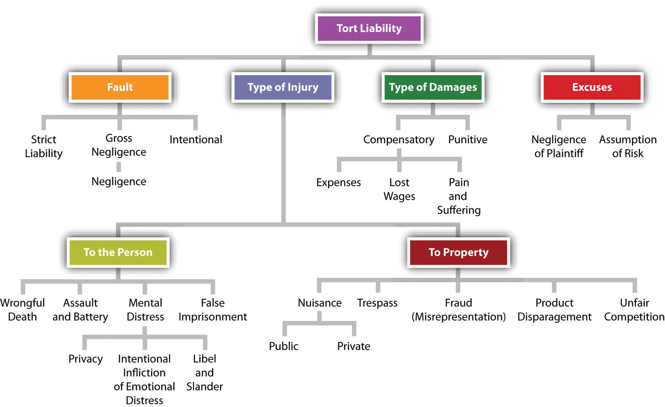
klgupta.in
https://courses.lumenlearning.com/masterybusinesslaw/chapter/introduction-to-tort-law/

Slide 24
Dr. Kalpeshkumar L Gupta
www.klgupta.in

